Slide 1


Software Dependability
GROUP MEMBERS :
MUHAMMAD HAMZA KHAN
FAHAD AHMED
AREEB ULLAH KHAN
PROFESSOR
FABIO PALOMBA
COORDINATOR
EMANUELE IANNUONE
GIAMMARIA GIOARDANO
PROJECT PRESENTATION

Slide 2
Context of the project
Vulnerability Testing also called Vulnerability Assessment is a procedure of evaluating security threat in software systems to reduce the probability of threats.
The purpose of vulnerability testing is reducing the possibility for intruders/hackers to get unauthorized access of systems.

Slide 3
Vulnerability Assessment
Examples of threats that can be prevented by vulnerability assessment include:
SQL injection, XSS and other code injection attacks.
Escalation of privileges due to faulty authentication mechanisms.
Insecure defaults – software that ships with insecure settings, such as a guessable admin passwords.

Slide 4
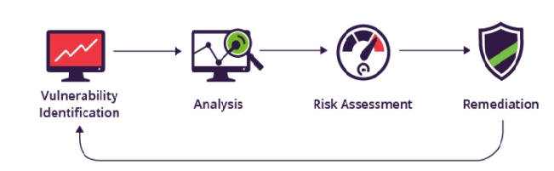
Vulnerability assessment Security scanning process
The security scanning process consists of four steps: testing, analysis, assessment and remediation.

Slide 5
Goals of the project
We must examine authentication inadequacy if the application:
Permits automated attacks such as credential stuffing, where the attacker has a list of valid usernames and passwords.
Permits brute force or other automated attacks.

Slide 6
Goals of the project
Permits default, weak, or well-known passwords, such as "Password1" or "admin/admin“.
Uses weak or ineffective credential recovery and forgot password processes, such as "knowledge-based answers", which cannot be made safe.

Slide 7
Methodological steps conducted to address the goals
How to Test ?
Black-Box Testing
There are several methods of bypassing the authentication schema that is used by a web application:
Direct page request (forced browsing)
Parameter modification
Session ID prediction
SQL injection

Slide 8
Methodological steps conducted to address the goals
Direct page request
If a web application implements access control only on the log in page, the authentication schema could be bypassed.
For example, if a user directly requests a different page via forced browsing, that page may not check the credentials of the user before granting access.

Slide 9
Methodological steps conducted to address the goals
Parameter Modification
Another problem related to authentication design is when the application verifies a successful log in based on a fixed value parameters. A user could modify these parameters to gain access to the protected areas without providing valid credentials.

Slide 10
Methodological steps conducted to address the goals
Session ID Prediction
Many web applications manage authentication by using session identifiers (session IDs).
Therefore, if session ID generation is predictable, a malicious user could be able to find a valid session ID and gain unauthorized access to the application, impersonating a previously authenticated user.

Slide 11
Methodological steps conducted to address the goals
SQL Injection (HTML Form Authentication)
SQL Injection is a widely known attack technique. This section is not going to describe this technique in detail as there are several sections in this guide that explain injection techniques beyond the scope of this section.

Slide 12

Methodological steps conducted to address the goals
Zed Attack Proxy (ZAP) is a free, open-source penetration testing tool being maintained under the umbrella of the Open Web Application Security Project (OWASP).
ZAP is designed specifically for testing web applications and is both flexible and extensible.
It stands between the tester’s browser and the web application so that it can intercept and inspect messages sent between browser and web application.

Slide 13

Preliminary results and findings
The Open Web Application Security Project (OWASP) is an open community dedicated to enabling organizations to develop, purchase, and maintain applications and APIs that can be trusted.
Broken authentication is an umbrella term for several vulnerabilities that attackers exploit to impersonate legitimate users online.

Slide 14
Preliminary results and findings
Weak passwords: The consumer creates a weak password like '12345' or 'pass123'. The hacker can use various password cracking techniques like rainbow tables and dictionaries to gain access to the system.
Weak cryptography: Using weak encryption techniques like base64 and weak hashing algorithms like SHA1 and MD5 make credentials vulnerable.

Slide 15
Preliminary results and findings
Poor session management
Let’s assume you like playing online games. You log in to the application and make several interactions with the network.

Slide 16
Preliminary results and findings
The following points list the scenarios that can cause broken authentication.
Weak usernames and passwords.
Session fixation attacks.
URL rewriting.
Consumer identity details are protected when stored.
Consumer identity details are transferred over unencrypted connections.

Slide 17
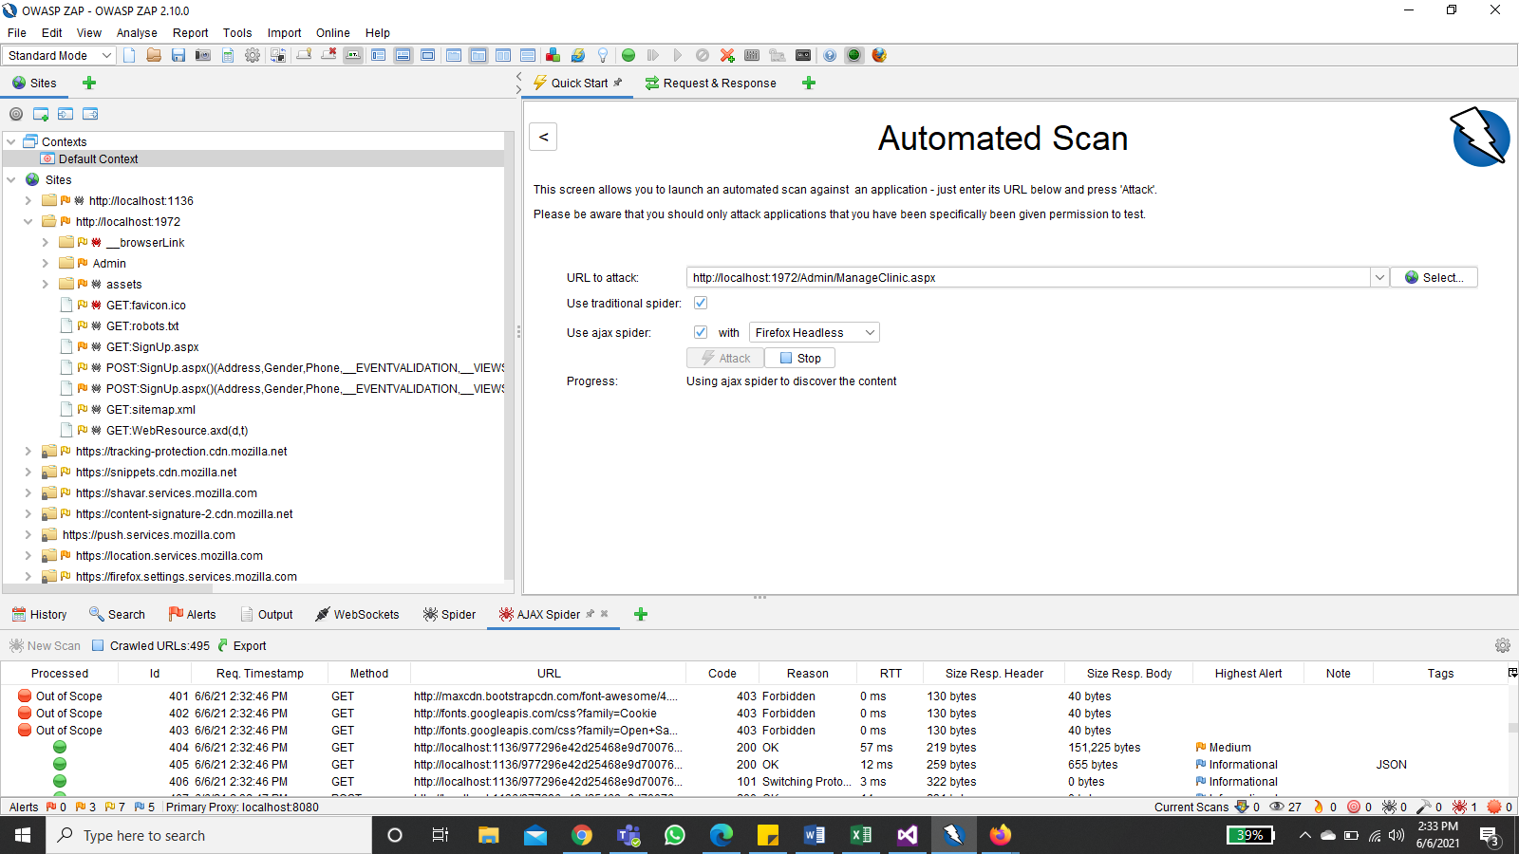
Implications of the results

Slide 18
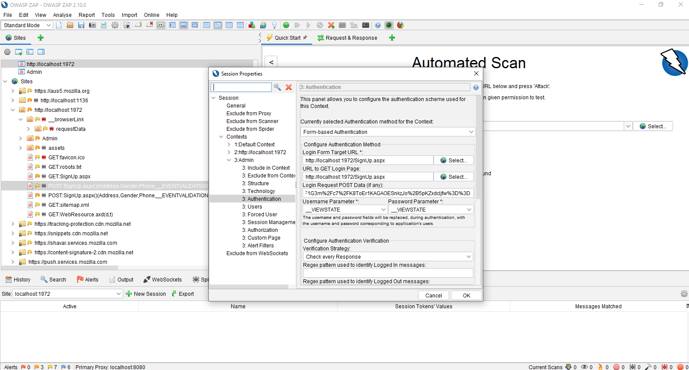
Implications of the results

Slide 19
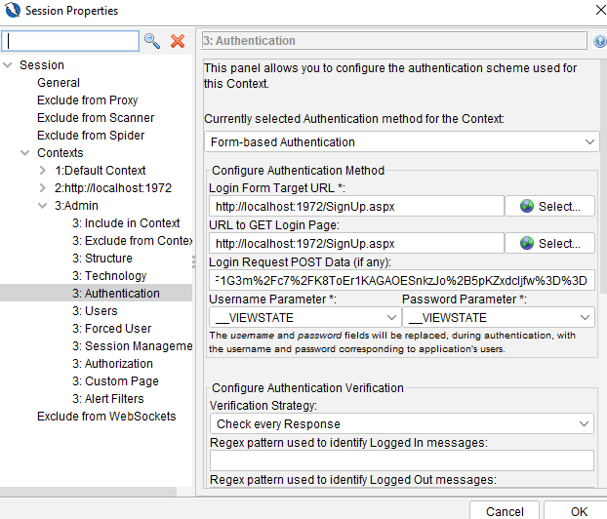
Implications of the results

Slide 20
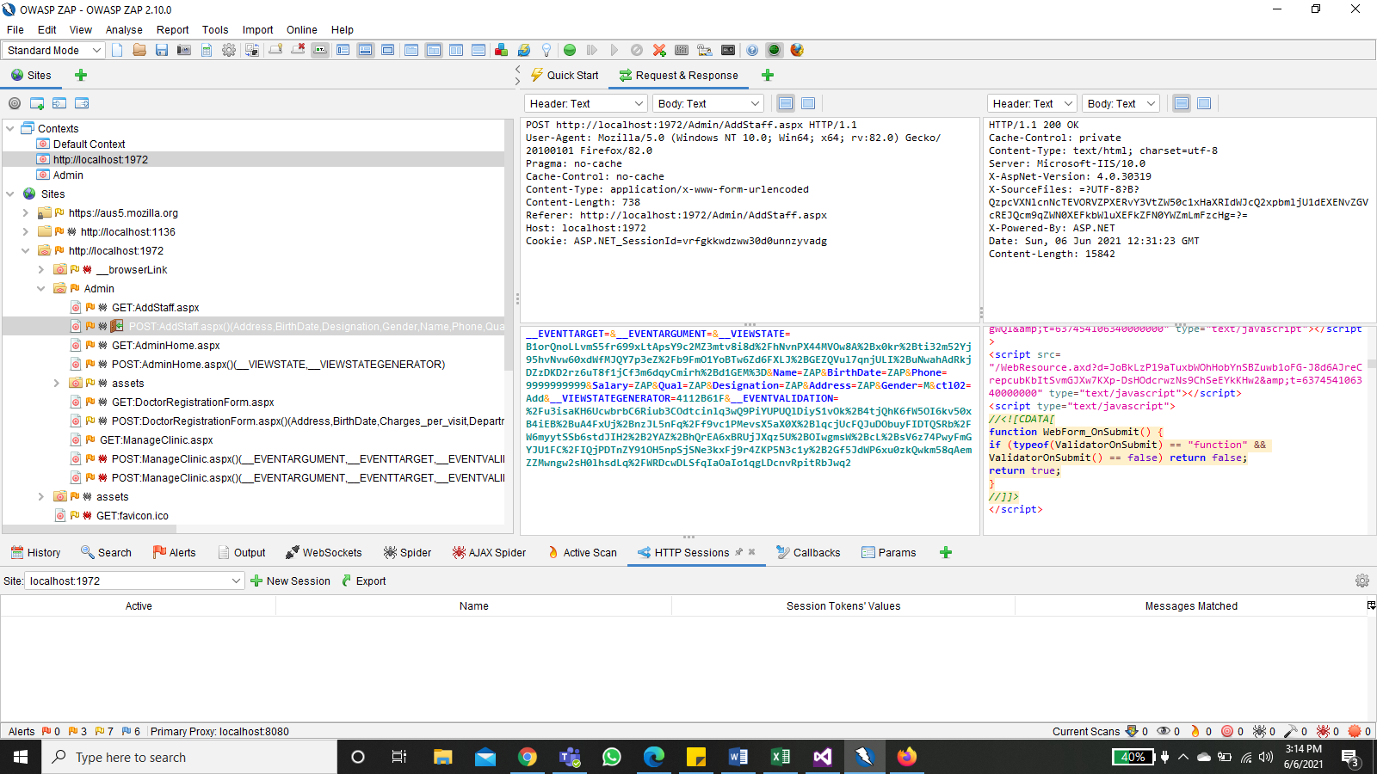
Implications of the results

Slide 21
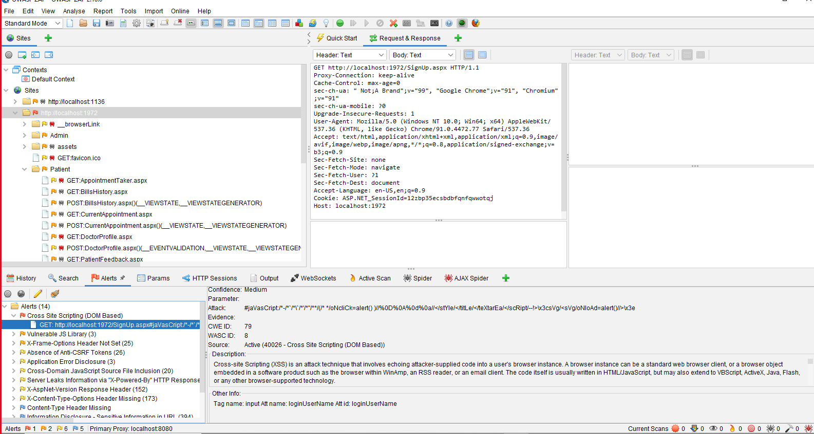
Implications of the results

Slide 22
Conclusion
In Software Engineering, Vulnerability Testing depends upon two mechanisms namely Vulnerability Assessment and Penetration Testing.
Both these tests differ from each other in strength and tasks that they perform.
Consider security at all stages of development cycle by its customizing tools. Authentication security testing tool that scans through your web application to identity any security vulnerabilities as possible, ZAP generates the scan report in the form of Alerts that are marked with color coded flags which is helpful for identifying the weakness of authentication by it customize priorities.
It is providing best approach to find application’s bug by its selective testing type and then user can easily resolve bugs.

Slide 23
THANK YOU

